Slide 1
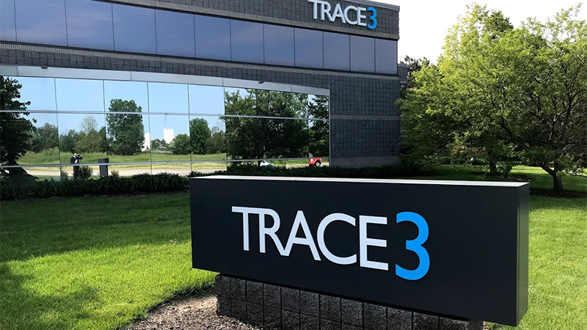

BUDT 748
Group 1
Meeting Management
Tool

Slide 2


Trace3 Meeting Management Tool - Project Introduction
Client & it’s Business:
Trace3 is an IT consulting organization specializing in AI, data, cloud and cybersecurity, with the unique ability to harness emerging trends to help clients realize value from their technology investments.
Founded in 2002 and headquartered in Irvine, California
Problem Statement:
There's a challenge in accurately tracking and reporting the time each participant spends in meetings.
This leads to a lack of insight into time allocation and resource utilization across various projects for resources outside of the Strategic Initiatives Project Management team.
This tool will aid the client in ensuring equitable distribution of stakeholder meeting time and project resource planning.

Slide 3
Trace3 Meeting Management Tool - Project Introduction
Purpose of Prototype System:
Optimizing Stakeholder Time Commitment
Develop a solution to gather meeting activity on projects tracked by the Strategic Initiatives team.
Avoid burdening stakeholders who have multiple high-priority commitments.
Efficient Meeting Data Collection
Design a streamlined system to automate data storage, processing and retrieval for meetings & participants.
Visualization of Metrics & Analytics
Dashboard with insightful metrics, KPIs and analytics.
Enabling informed decision-making & efficient project resource scheduling.
Primary Stakeholders:
Strategic Initiatives Team at Trace3
IT & Security Team

Slide 4
Research
Planning Phase:
Recurring meetings and interviews with Trace3’s Strategic Initiative team helped us identify key challenges and objectives for the project.
We understood the need for a meeting management tool and how it can benefit the company in the near future.
System Analysis Phase:
Capturing Trace3’s as-is system using diagrams such as DFD, physical DFD, ERD, feasibility analysis and candidate solutions matrices to map inefficiencies in meeting management.
Understanding the need for stakeholder time management, attendance analytics, and project resource optimization.
Design Phase:
Modeling Trace3’s to-be system using diagrams such as input-output design, data-to-process CRUD matrix and implementation plan to achieve project objectives and solve Trace3’s problem.
Researched API capabilities (Zoom & MS Teams) and addressed mock data requirements due to API limitations.

Slide 5


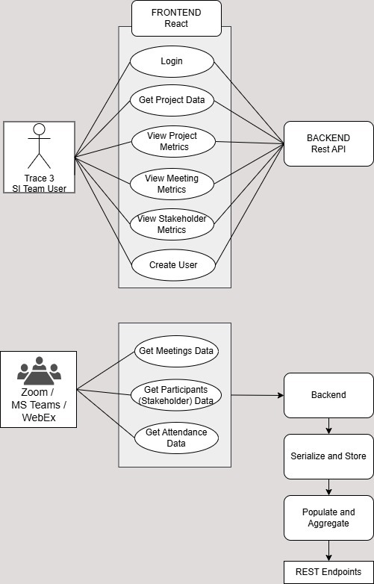
Design
Frontend: Built using React, the system enables users to:
Access project data, meeting metrics, and stakeholder metrics.
Backend: Developed with Django REST APIs, it processes and aggregates data:
Integrates with external platforms like Zoom & MS Teams to fetch meeting, participant, & attendance data.
Serializes and stores the data in a structured format for further aggregation and analysis.
Integration: APIs were designed to ensure seamless communication between the frontend, backend, and external tools, supporting features like data aggregation and real-time metric updates.

Slide 6
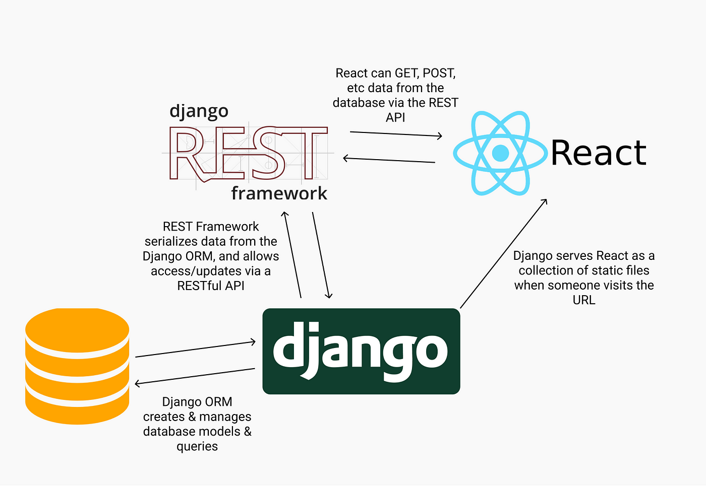

Development
Prototype built using Django REST Framework (DRF) to create an efficient, maintainable API backend.
Designed Key Models: Project, Meeting, Stakeholder, and Meeting Attendance to store and manage data.
Developed custom API endpoints to calculate KPIs like total meeting hours, weekly participation, and attendance percentages.
API Endpoints:
GET requests for retrieving projects, meetings, and stakeholders.
Custom actions for calculating hours based on project and stakeholder data.
Business Logic:
Calculated total meeting hours and filtered data based on date range, project, or stakeholder email.
Technology Stack:
Django, Django REST Framework, MySQL.

Slide 7


Testing and Deployment
Unit Testing:
Django TestCase for validation & data integrity.
Integration Testing:
Leveraged tools like Postman and Django Rest Framework's APIClient to validate end-to-end workflows and ensure seamless interaction between various components.
Verified that custom endpoints (e.g., KPI calculations) integrated correctly with models and returned the expected results.
Manual Testing:
Employed Swagger UI for manual testing and real-time API exploration, simulating user interactions and edge case scenarios.
Ran exploratory tests to check for performance bottlenecks, data inconsistencies, and misbehaving API endpoints.
Deployment: The tool is pre-configured for deployment with comprehensive documentation provided, ensuring a smooth transition to the client's systems when ready.

Slide 8
Major Challenges & Resolution
Challenge: Limited access to requested meeting data due to security clearance restrictions. Resolution: Conducted mock meetings on Zoom and Teams to collect real-world data. This ensured the platform was built on real meetings and not mockup data created through an LLM.
Challenge: Did not get access to development environment of Trace3. Resolution: We developed the platform on a test environment & used our university’s GitHub repository. We will provide Trace3 with extensive documentation to enable a seamless integration of the tool with their system.
Challenge: Paid organizational accounts for Zoom and Microsoft Teams were required for mock meetings and data collection. Resolution: Researched and reviewed API documentation for data retrieval and KPIs, and also got paid accounts for both platforms, and got approval from the Microsoft developer program.

Slide 9
Live Demo
Trace3 Meeting Management Tool

Slide 10
Result & Recommendations
Results:
We showcased the platform to the client and received positive feedback.
The prototype tool's dashboard includes the following views: Projects, Stakeholders, Upcoming Project Meetings, and Project-wise Overview for Stakeholders.
The prototype has been tested with internally generated meeting data and is compatible for seamless integration with Zoom & MS Teams.
API integration and Deployment steps are being documented to support Trace3 with integration of the tool into their system.
Recommendations:
Trace3 must adhere to the established meeting naming conventions to ensure accurate data capture within the tool.
In order to integrate this platform for Zoom and MS teams, Trace3’s IT team will be required to follow the API and deployment documentation.
Access to the platform will be limited to the members of the Trace3 Strategic Initiatives team.
The dashboard can be used along with the project resource matrix on Smartsheets, which in our opinion will help the SI team in meeting its objectives.

Slide 11
Thank You!

Slide 12
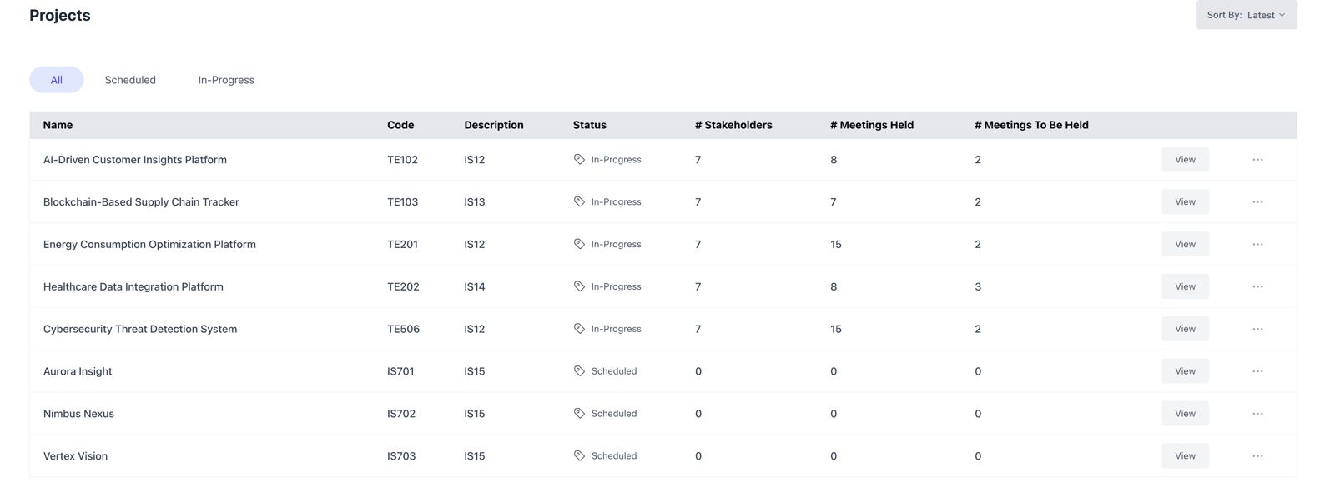
Static Representation of Live Demo
Projects

Slide 13
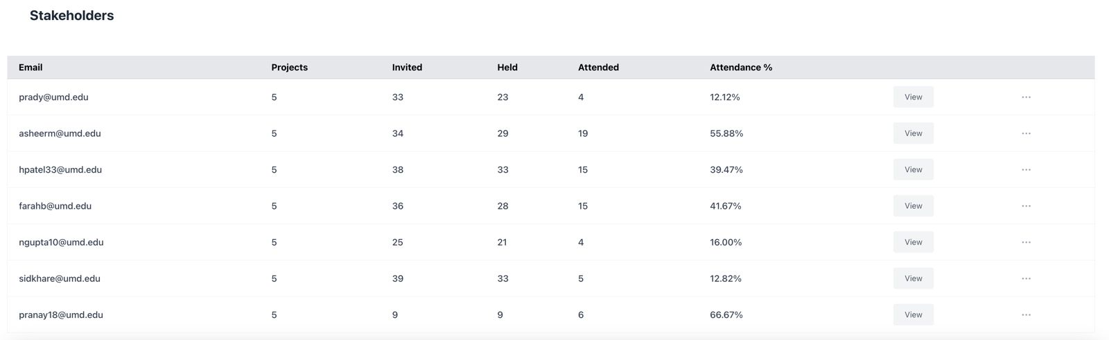
Static Representation of Live Demo
Stakeholders

Slide 14
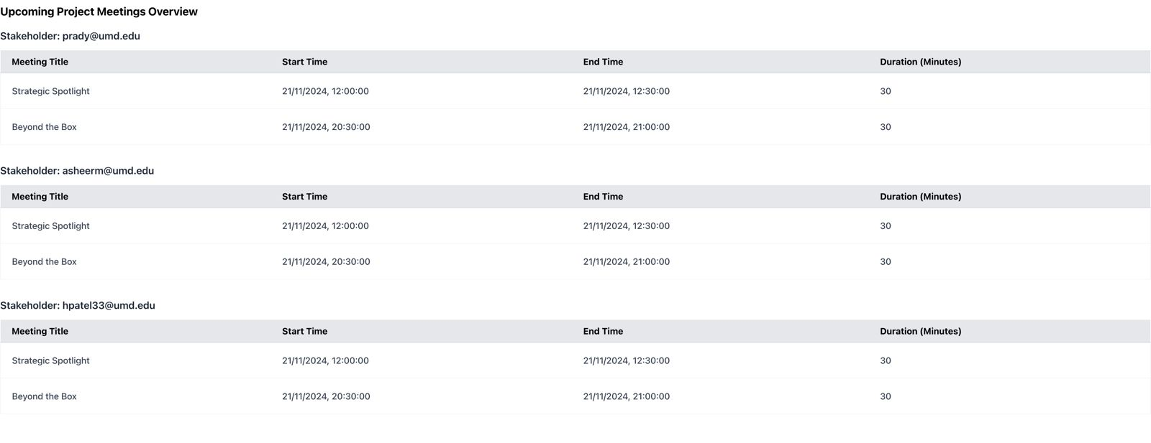
Static Representation of Live Demo
Upcoming Project Meetings

Slide 15
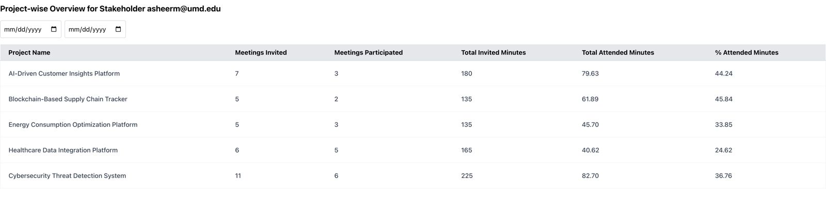
Static Representation of Live Demo
Project-wise Overview for Stakeholder

Slide 16
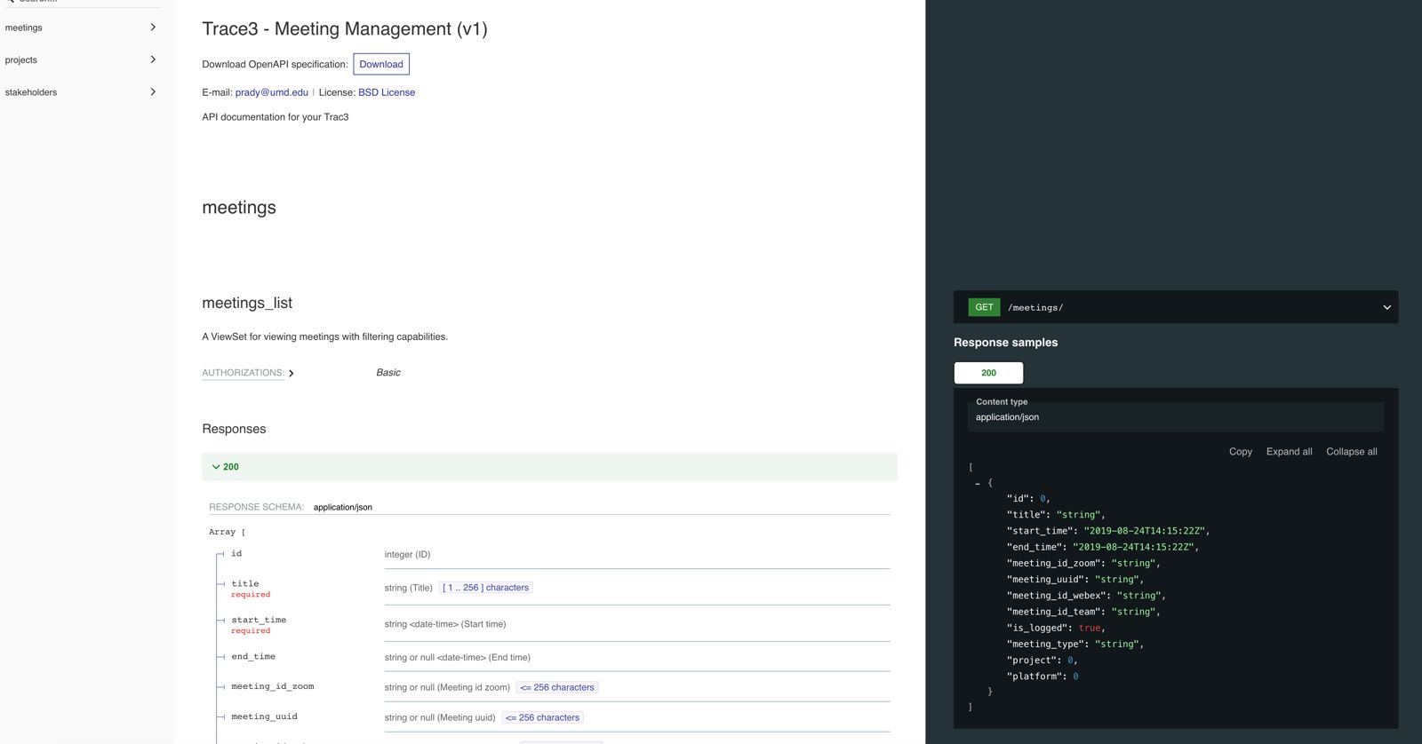
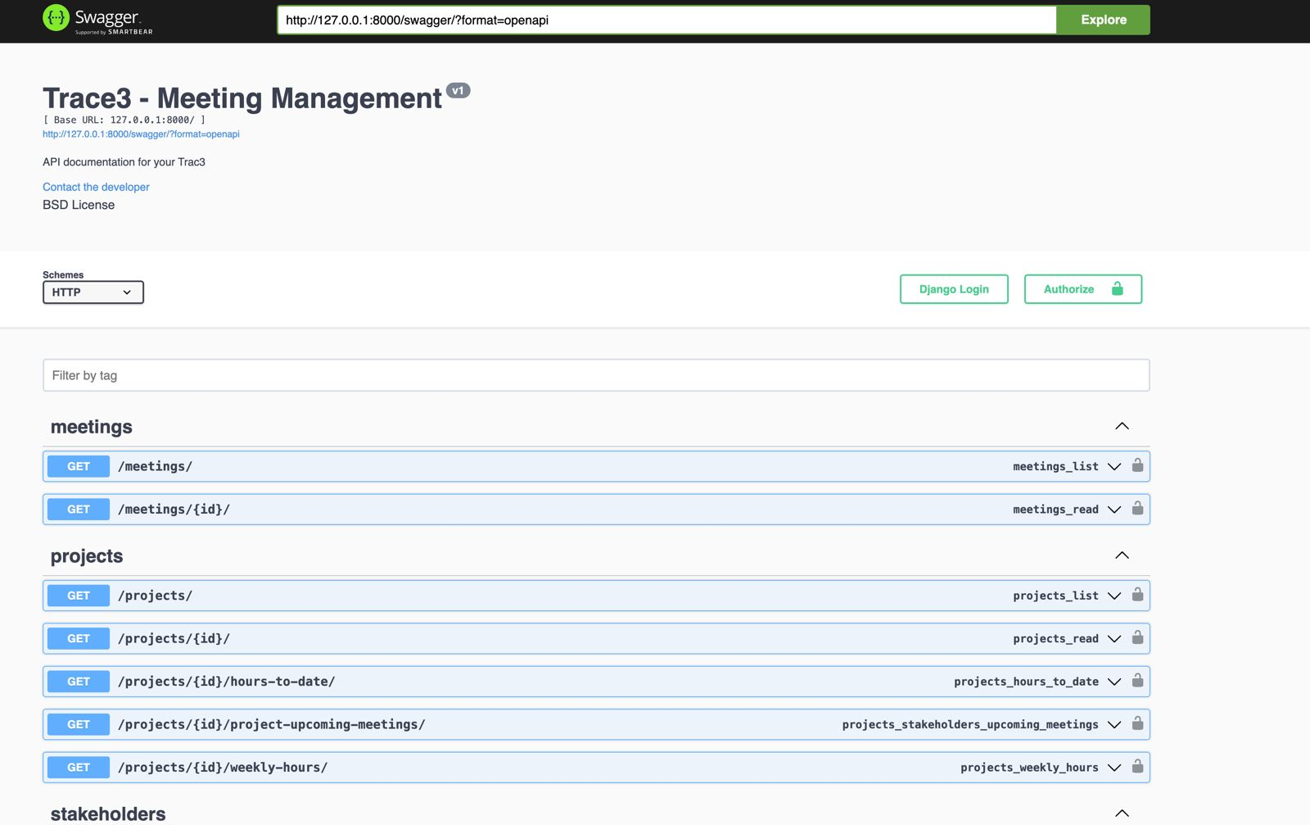
Static Representation of Live Demo
API Documentation

Slide 17
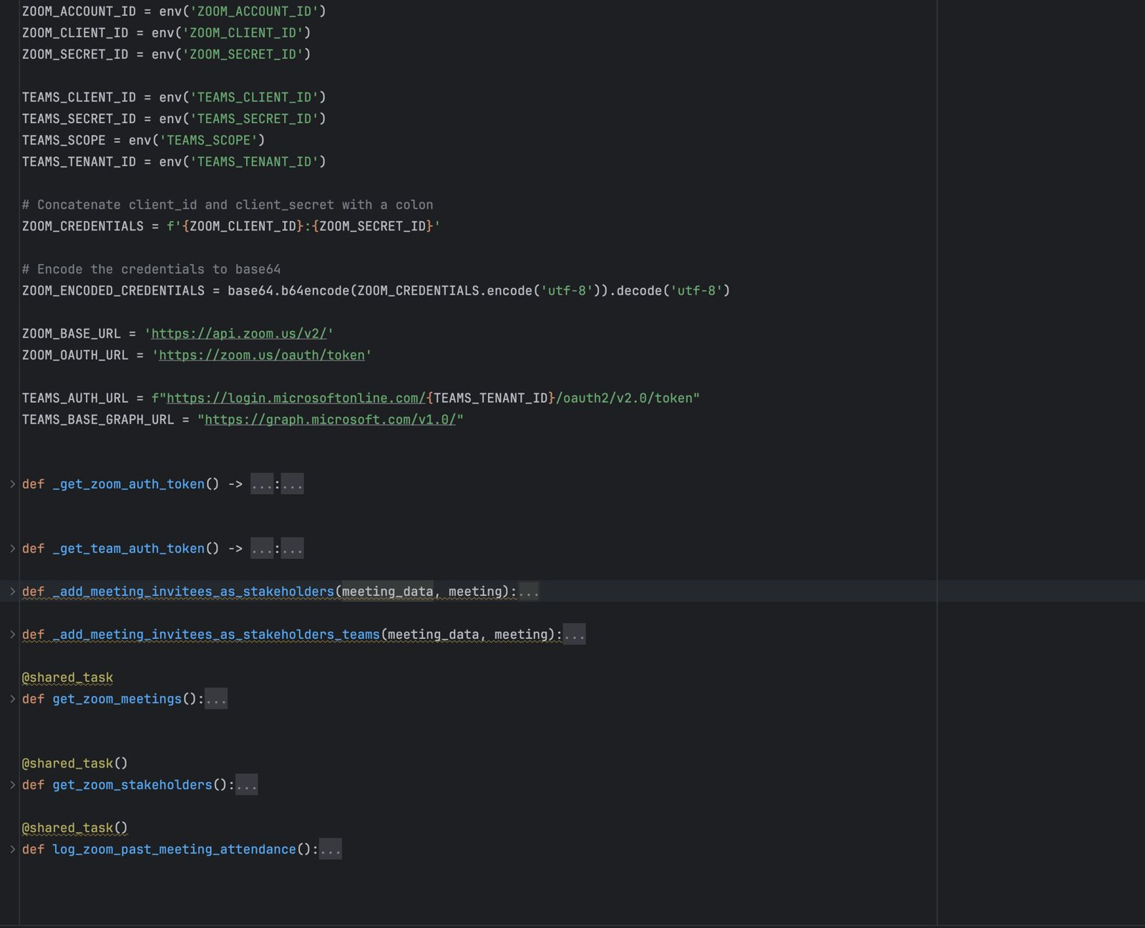
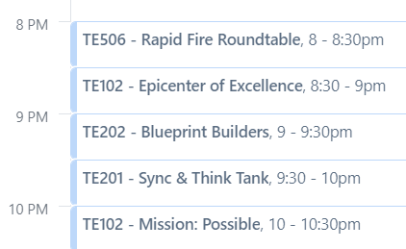
Static Representation of Live Demo
Zoom and MS Teams Data Collection

